Slide 1
Cross-Domain Sentiment Analysis Using Hotel Reviews
Naive Boyes
Aloysius (aloli333), Andrei (andpl509), Daniel (danhu849), Nicholas (nicya941), Simon (simah964), Sio (kuesi912)

Slide 2

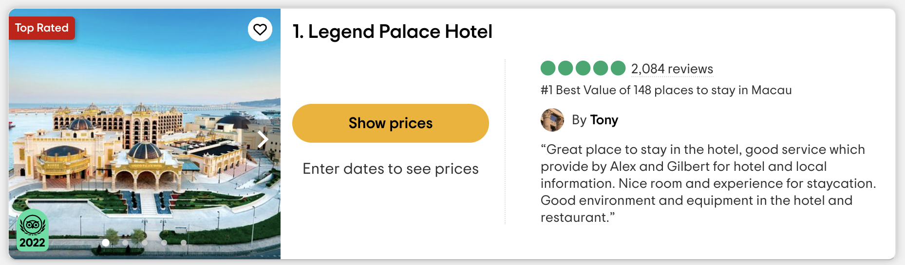
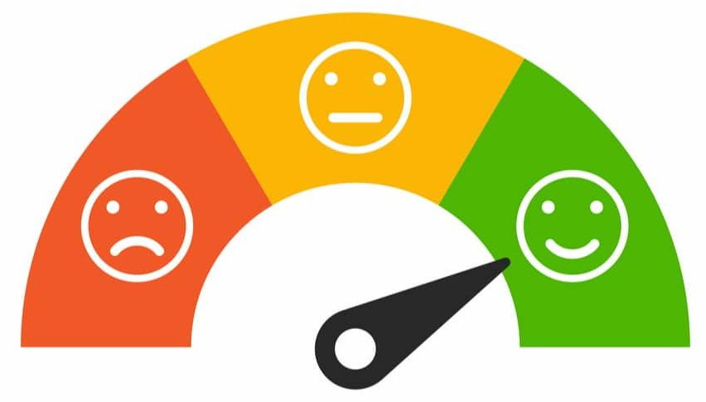
What is Sentiment Analysis?
To Positive/Negative/Neutral
From Text
Notes:
First of all, let me introduce what is sentiment analysis.
In a nutshell, what we gonna do here is to determine and extract the emotional tone from the text.
We can apply it into various fields such as social media comment, product reviews, news articles, etc.

Slide 3
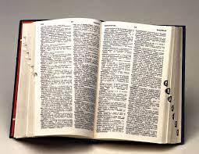

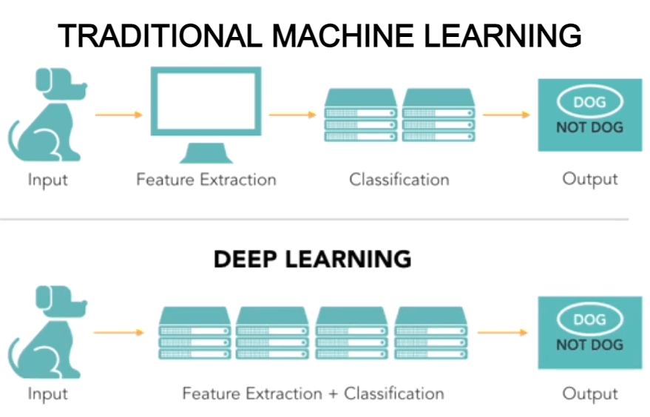
Types of Sentiment Analysis
Rule-Based/
Lexicon-Based
Machine Learning
Hybrid
Traditional Machine Learning
Deep Learning
Notes:
And generally, there are 3 types of sentiment analysis.
The first one is the rule-based analysis, here we use the preset rule or guideline to identify the sentiment of the text.
The second type is the machine learning, which can be classified into two types: Traditional Machine Learning and Deep Learning.
In traditional machine learning, the algorithms are mainly based on the mathematics model while in deep learning, we use the neural network to deal with it.
And lastly, is the hybrid one, here we analyse using a model but we also have a preset guideline and rule to help with it.

Slide 4
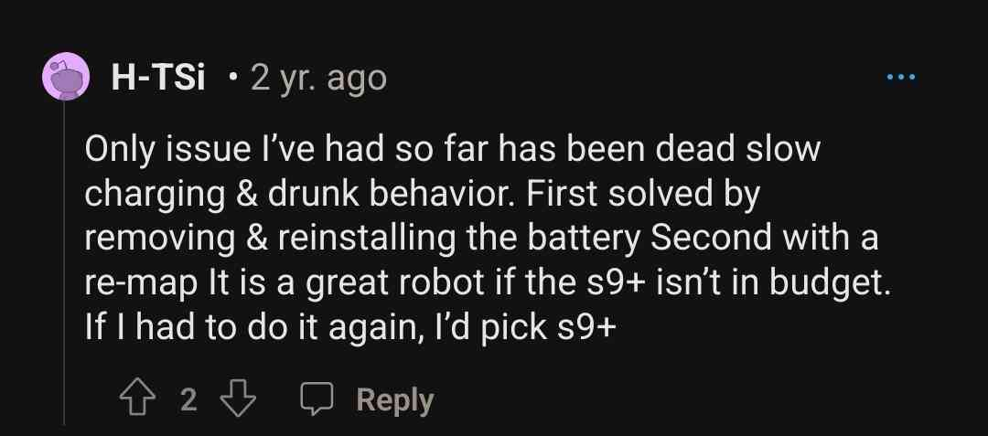
What is Cross-Domain Sentiment Analysis?
To Obtain Sentiment Of
Unlabelled Data
(E.g. Reddit Comment on a Roomba Robot)
Using Labelled Data
Notes:
Then, let we go deeply, what is cross-domain sentiment analysis? Here we have an explicit example.
We train the model using a source data, here we use the reviews in TripAdvisor, then we use this model to deal with the text from the other fields, that’s a kinda cross-domain sentiment analysis. For example, we can use this model to analyse and predict the sentiment from the reddit comments of the computer brand. That’s a kinda implementation of this method.

Slide 5
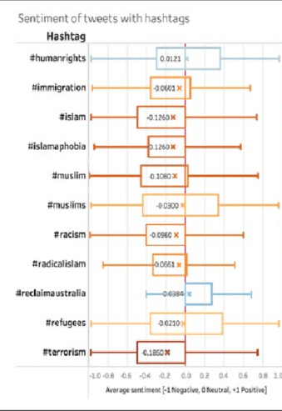
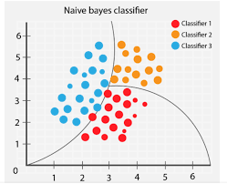
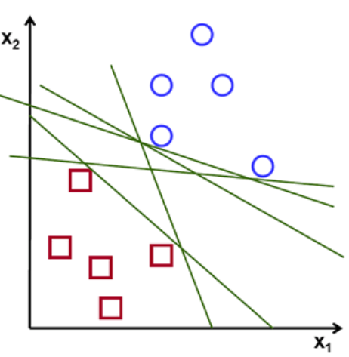
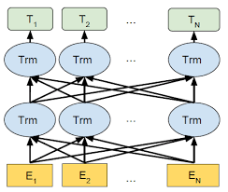

Models Utilised
1. Naive Bayes
4. SVM
(Support Vector Machine)
6. VADER
(Valence Aware Dictionary for Sentiment Reasoning)
2. Decision Tree & 3. Random Forest
5. BERT
(Bidirectional Encoder Representations from Transformers)
Traditional Machine Learning Models
Non- Traditional Machine Learning Models
Notes:
Our project utilises 6 models as shown here. For easier understanding, we classify them into traditional and non-traditional ML models. We have 4 traditional machine learning models, namely: Naive Bayes, Decision Tree, Random Forest and Support Vector Machine (or SVM).
And we have 2 non-traditional machine learning models, namely: Bidirectional Encoder Representations from Transformers (or BERT) and Valence Aware Dictionary for Sentiment Reasoning (or VADER).
Now onto the four traditional machine learning models.
A random forest is a type of machine learning algorithms that is used for both classification and regression tasks. It is an ensemble learning method that combines multiple decision trees to make predictions.
The Random Forest works by constructing a large number of decision trees on randomly selected subsets of the training data. Each decision tree in the random forest is built independently using a different subset of the training data and a random subset of the features. The final prediction is then made by aggregating the predictions of all the decision trees in the forest.
Next, the Support Vector Machine (SVM) is a supervised machine learning algorithm that is also used for classification and regression tasks. It works by constructing a hyperplane or a set of hyperplanes that can be used to separate data into different classes. SVM finds the optimal hyperplane by maximizing the margin between the hyperplane and the nearest data points of each class.
Lastly, Naive Bayes. This is a probabilistic machine learning algorithm that is widely used for classification tasks, such as spam filtering, sentiment analysis, and document classification. It is based on Bayes' theorem and assumes that the features are independent of each other, hence the term "naive".
Naive Bayes works by calculating the probability of a given data point belonging to each class, based on the probabilities of the features. It uses Bayes' theorem to calculate the posterior probability of a class given the data point and the prior probability of the class. The class with the highest posterior probability is then selected as the predicted class for the data point.

Slide 6

Research Questions
1. Would models perform better in predicting a 5-class output (Rating) or 3-class output (Sentiment)?
2. Which model would perform better across different domains?
Notes:
Now we move on to our main focus of this project. With this project, we try to answer the two questions shown on this slide.
First we ask if models perform better in predicting a 5-class output of rating one to five or would models perform better when predicting a 3-class output, i.e. the sentiment output of positive, negative or neutral.
Next, we try to figure out which model would perform better across different domains.

Slide 7


Different Domains?
Trained & Tested on TripAdvisor Data
Model Trained on
Test on
vs
Other Datasets
Model Trained on
Test on
(for example)
Notes:
What different domains? You might be wondering. Well we would like to firstly find out which model performs best when trained on one dataset like TripAdvisor Hotel Reviews, and tested on an unseen section of the same dataset, TripAdvisor Hotel Reviews again.
Next, we would also like to find out which model performs best when trained on one dataset, TripAdvisor Hotel Reviews, and tested on an entirely different dataset like Amazon Fine Food Reviews for example.

Slide 8
Hypotheses
RQ1. Would models perform better in predicting a 5-class output (Rating) or 3-class output (Sentiment)?
Model Performance: Better for 3-class output
(Sentiment: Positive/Negative/Neutral)
Notes:
For research question 1, we hypothesise that across all models, the performance would be better for a 3-class output i.e. a sentiment output of “Positive/Negative/Neutral” compared to a 3-class output of one to five.
One reason for this hypothesis would be that it is easier for the model to differentiate between positive and negative sentiment compared to differentiating between a rating of 1 and 2 or 4 and 5 as there are no specific rule on which positive word belong on a rating of 4 or a rating of 5, similarly which negative word belongs to 1 and 2.

Slide 9
Hypotheses
RQ2. Which model would perform better across different domains?
TripAdvisor | Support Vector Machine (SVM)
Other Datasets (Sentiment) | BERT
Other Datasets (Rating) | BERT
Notes:
And for research question 2, we expect the Support Vector Machine (SVM) to be the best performing model for TripAdvisor data where we train and test on the same dataset.
And BERT to be the best performing model for both sentiment and rating when we train on one dataset and test on another. This is because BERT is trained on a much larger corpus than our own, we expect that this model would perform better for other datasets.

Slide 10
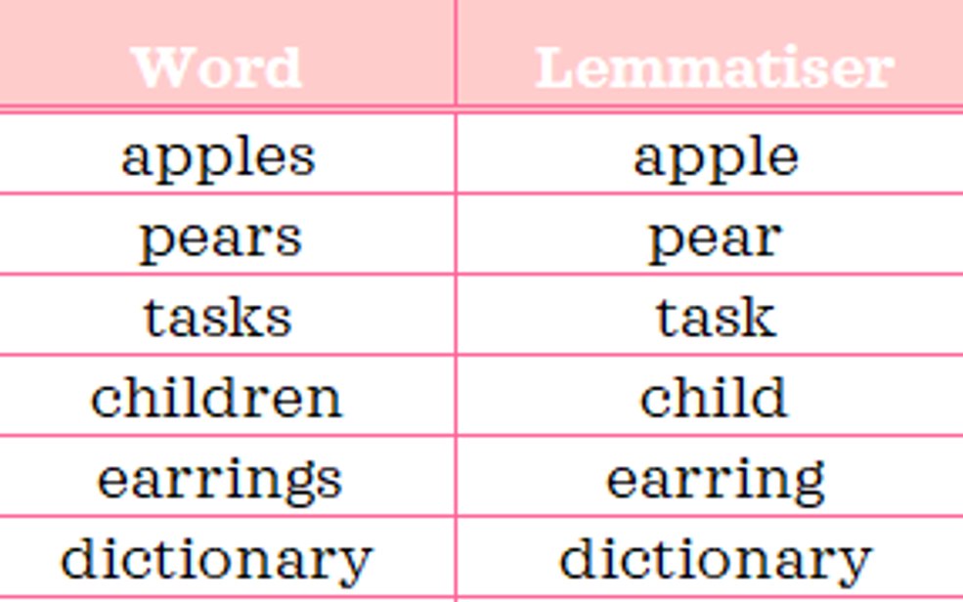
Data Preprocessing
comfortable.however
outstanding.i
comfortable however
outstanding i
Conjoined Words
appreciated,
bad-
appreciated
bad
Trailing Symbols
changing
changed
change
changer
changes
2004
1962 2006
change
Numbers
removed
Data Cleaning
Lemmatization
Notes:
However, before we begin with the analysis, there are some data preprocessing required for the 3 traditional machine learning models, specifically data cleaning like getting rid of these conjoined words, trailing symbols and numbers, and lemmatization, where we “standardise” the different word form of the same base word as seen in the examples in the slide.

Slide 11
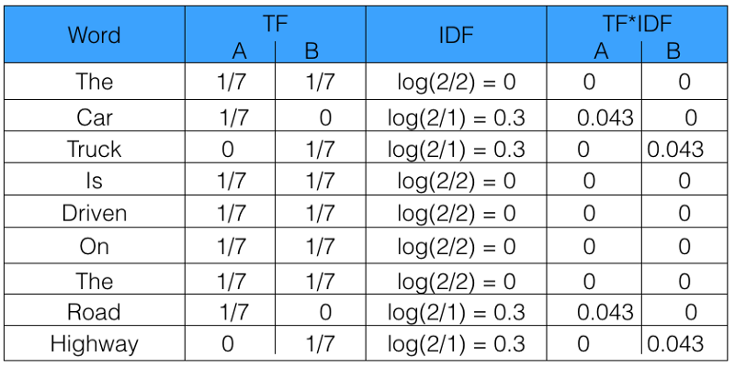
Data Preprocessing
Feature Vectorisation
(TF-IDF)
Notes:
And after which, we then conducted feature vectorisation (i.e. term frequency-inverse document frequency) which converts the individual words into vectors that the model understands.

Slide 12
Methodology
Dataset | Qty of Data | Vocab Size
TripAdvisor Hotels | 20,491 | 88,788
Amazon Fine Food | 568,454 | 586,944
Google Play Store | 12,495 | 26,742
Women’s E-commerce Clothing | 22,641 | 38,473
Amazon Unlocked Mobile Phones | 413,778 | 255,061
Type of Data | Dataset Percentage
Train Data | 80%
Test Data | 10%
Validation Data | 10%
Data Splitting
(TripAdvisor)
Dataset Info
Notes:
Now, we will move on to the specific datasets that we have conducted our research on. First, would be the TripAdvisor Hotel Reviews with about 20,000 reviews and a vocab size of 88,788. And because this is our training dataset, the TripAdvisor Hotel Reviews was split the data according to the table shown, 80% on training data, 10% on test data and the last 10% on validation.
And the information of the other four datasets, like the Amazon Fine Food Reviews, which is used for our cross domain sentiment analysis, are as shown in the slide.

Slide 13
Methodology
Why did we choose TripAdvisor Hotel Reviews as the Training Dataset?
Great variety of explanations for platform/hotels.
Wide range of topics (facilities/products/services/food) to review: Multiple words defining things as good or bad.
Why did we not use Amazon/Others as the Training Dataset?
Words used in these reviews may be too product-centric.
Dataset is too large to train.
Notes:
You might be wondering, why did we choose TripAdvisor Hotel Reviews as a training dataset for our cross domain sentiment analysis. Well, firstly the TripAdvisor dataset has a significant age range with reviews from people as long as they are 18 years old and above.
There are also people from all over the world of different background using this platform as it is a travel site after all. This will allow the model to be trained on different forms of describing something is positive or negative.
Furthermore, for a hotel, there are also several topics for consumers to review, for example, hotel facilities, product, food and services. This gives the model, again, multiple types of words used to describe different things.
Now, why did we not use Amazon or the other datasets as the training dataset? Simply put, the datasets would have been too product-centric, and some are also too large to be used to train.

Slide 14
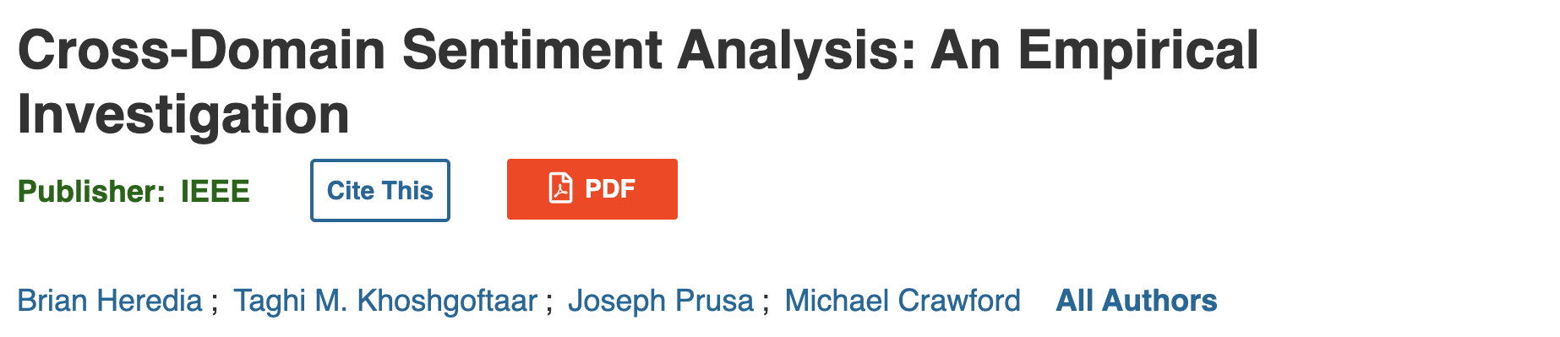
Related Works
Taken from: https://ieeexplore.ieee.org/document/7785737
Focus: Reviews and Tweets
Results:
Model trained on Tweets is effective for Reviews.
Model trained on Reviews ineffective for Tweets.
Notes:
Before we get to the results, there are indeed some related works to what we have done in this project.
For instance, we found this investigation online which was conducted in 2016. The researchers conducted cross-domain sentiment analysis on datasets containing reviews and tweets.
And from their research they found that the model trained on Tweets were effective on predicting the sentiment for reviews and the model trained on reviews were ineffective on predicting the sentiment for Tweets.

Slide 15
Results
RQ1. Would models perform better for a 3-class output (Sentiment) rather than a 5-class output (Rating)?
Model Performance: Better for “Positive/Negative/Neutral”
Notes:
Now, let’s move on to our results.
As expected, the models, all six of them, performed better for a 3-class output, i.e. the sentiment output of positive, negative and neutral. The accuracies can be seen on the next slide.

Slide 16
Results
RQ1. Would models perform better for a 3-class output (Sentiment) rather than a 5-class output (Rating)?
 | Accuracy
Models | Rating | Sentiment
Naive Bayes | 51% | 78%
Decision Tree | 52% | 79%
Random Forest | 57% | 82%
SVM | 64% | 86%
BERT | 66% | 88%
VADER | NA | 81%
Probable Reasons:
No global rules for review score.
Easier to differentiate between positive and negative words.
Notes:
As seen from the table on the slide, every one of the 6 models had a higher accuracy for a 3-class output, i.e. predicting sentiment of positive, negative or neutral, compared to a 5-class output, i.e. predicting a rating from 1 to 5.
One probable reason for this result would be that it is easier for the model to differentiate between positive and negative sentiment compared to differentiating between a rating of 1 and 2 or 4 and 5 as there are no specific rule on which word belong on a rating of 4 or a rating of 5, similar for 1 and 2.
Another probable reason would be that the scoring for the words would be very similar between words in reviews of rating 4 and 5, similar for 1 and 2, and thus we the model predicts 1, 2, 4 or 5 less accurately.

Slide 17
Results
RQ1. Would models perform better for a 3-class output (Sentiment) rather than a 5-class output (Rating)?
Precision | Rating | Sentiment | Precision
71% | 5 | Positive | 72%
44% | 4
47% | 3 | Neutral | 49%
50% | 2 | Negative | 90%
77% | 1
Notes:
Furthermore, we can also look into the precisions of the various outputs. As shown in the slide above, it can be seen that the precision on average is much higher for the 3-class output (sentiment) compared to that of the 5-class output (rating)

Slide 18
Results
RQ2. Which model would perform better across different domains? (TripAdvisor vs Other Datasets)
TripAdvisor | BERT
Other Datasets (Sentiment) | VADER
Other Datasets (Rating) | Random Forest
(Different from our hypothesis)
Notes:
For research question 2, which model would perform better across different domains.
When we train on the TripAdvisor dataset and test on an unseen section of the same dataset, BERT performed the best out of the 6 models.
When we train on the TripAdvisor dataset and test on other datasets, VADER performed the best out of the 6 models for sentiment, and Random Forest performed the best out of the 6 models for rating.

Slide 19
RQ2. Which model would perform better across different domains? (TripAdvisor vs Other Datasets)
Trained & Tested on TripAdvisor Data
Models | Accuracy (Rating) | Accuracy (Sentiment)
Naive Bayes | 51% | 78%
Decision Tree | 52% | 79%
Random Forest | 57% | 82%
SVM | 64% | 86%
BERT | 66% | 88%
VADER | NA | 81%
Notes:
Looking closer at the instance when we train on the TripAdvisor dataset and test on an unseen section of the same dataset
As you can see from the table in the slide, for both rating and sentiment outputs, BERT performed the best with an accuracy of 66% for rating output and an accuracy of 88% for sentiment output.

Slide 20
RQ2. Which model would perform better across different domains? (TripAdvisor vs Other Datasets)
Other Datasets (Sentiment)
 | Accuracy (Sentiment: Positive/Negative/Neutral)
Dataset | Naive Bayes | Decision Tree | Random Forest | SVM | BERT | VADER
TripAdvisor Hotels | Model Trained on This Dataset |  |  |  |  | N/A
Amazon Fine Food | 78% | 76% | 79% | 78% | 46% | 81%
Google Play Store | 45% | 52% | 46% | 53% | 52% | 63%
Women’s E-commerce Clothing | 77% | 50% | 77% | 75% | 61% | 79%
Amazon Unlocked Mobile Phones | 69% | 54% | 71% | 73% | 61% | 71%
Average Accuracy | 67.3% | 58.0% | 68.3% | 69.8% | 52.7% | 73.5%
Notes:
Looking closer at the instance when we train on the TripAdvisor dataset and test on other datasets
We found that for sentiment output, VADER had the highest average accuracy of 73.5% and SVM coming in close behind at an accuracy of 69.8%.

Slide 21
RQ2. Which model would perform better across different domains? (TripAdvisor vs Other Datasets)
Other Datasets (Rating)
 | Accuracy (Rating: 1 to 5)
Dataset | Naive Bayes | Decision Tree | Random Forest | SVM | BERT | VADER
TripAdvisor Hotels | Model Trained on This Dataset |  |  |  |  | N/A
Amazon Fine Food | 63% | 53% | 64% | 54% | 24% | N/A
Google Play Store | 24% | 30% | 24% | 33% | 31% | N/A
Women’s E-commerce Clothing | 55% | 50% | 56% | 47% | 32% | N/A
Amazon Unlocked Mobile Phones | 54% | 54% | 56% | 51% | 32% | N/A
Average Accuracy | 49.0% | 46.8% | 50.0% | 46.3% | 29.8% | N/A
Notes:
Next for rating outputs, we found that Random Forest had the highest average accuracy of 50.0% and Naive Bayes coming in close behind at an accuracy of 49.0%.

Slide 22
Discussion
Notable Observations:
BERT
TripAdvisor Reviews - Best
Other Datasets - Worst
Google Play Store Reviews
Accuracy was the lowest across all models
Notes:
Thank you Simon, I will be talking about a few notable observations from the results shown earlier on. Firstly, we noticed that our BERT model performed the best for our source domain, the TripAdvisor Hotel Reviews dataset, and the worst across all other datasets.
Secondly, we also noticed that among the datasets from different domains, all the models had the lowest accuracy for Google Play Store Reviews.

Slide 23
Discussion
Notable Observations:
BERT
TripAdvisor Reviews - Best
Other Datasets - Worst
Google Play Store Reviews
Accuracy was the lowest across all models
Probable Reasons:
BERT was fine-tuned on TripAdvisor Dataset
Reviews are much shorter and contain fewer words
Notes:
BERT performing worse:

Slide 24
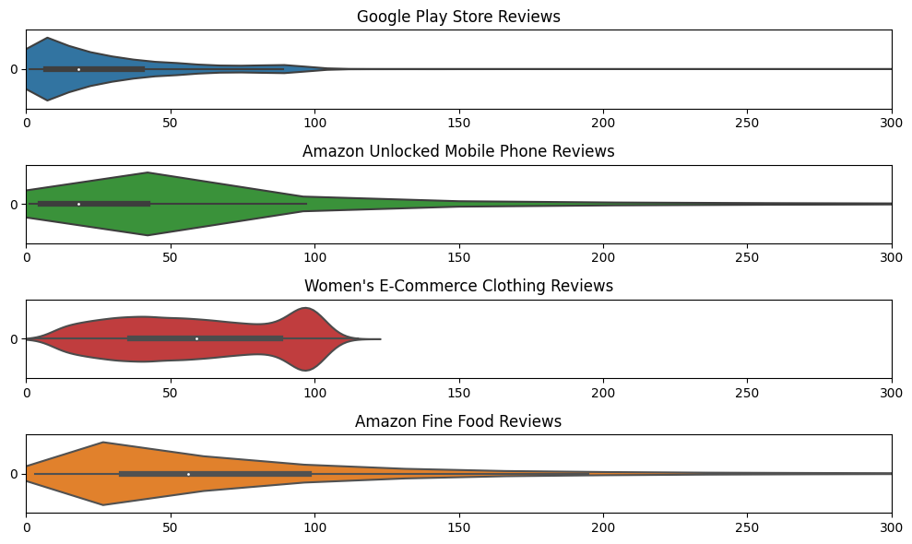
Discussion
Google Play Store Reviews vs Other Datasets
Shortest
Worst
Longest
Best
Review Length Comparison
Notes:
This slide shows a comparison of the review lengths of all the datasets in the other domain. The diagram shows the distribution of review lengths in each dataset. The topmost chart corresponds to Google Play Store Reviews, and we can see that most of the reviews are centred around

Slide 25
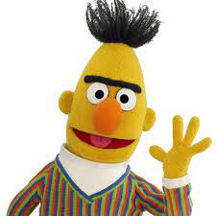

Conclusion
Feasibility
Most Feasible for Single-Domain Sentiment Analysis: BERT
Highest accuracy for Rating (66%) + Sentiment (88%)
Fine-tuning on dataset required
Most Feasible for Cross-Domain Sentiment Analysis: VADER
Highest Accuracy for Sentiment (73.5% avg.)
No training required, only a lexicon
Notes:
Feasibility:
Based on our results, feasible for the same domain (hotel reviews), and the following other domains:
Food Reviews
Clothing Reviews
Mobile Phone Reviews
Difficulties faced:
Data: Data required a considerable amount of cleaning, despite gold standard dataset on Kaggle
Hardware Limitations:
Difficulties in truly understanding why the
Improvements:

Slide 26


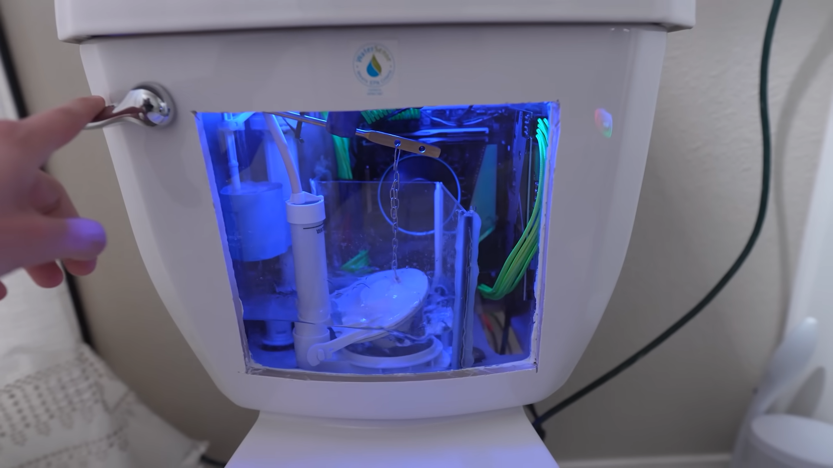
Conclusion
Difficulties Faced
Data Preprocessing
Required Data Cleaning
Despite Gold Standard on Kaggle
Hardware Limitations
Training/testing took very long
Notes:
Feasibility:
Based on our results, feasible for the same domain (hotel reviews), and the following other domains:
Food Reviews
Clothing Reviews
Mobile Phone Reviews
Difficulties faced:
Data: Data required a considerable amount of cleaning, despite gold standard dataset on Kaggle
Hardware Limitations:
Difficulties in truly understanding why the
Improvements:

Slide 27
Q&A

Slide 28
Image References
What is Sentiment Analysis?
TripAdvisor Review: https://www.tripadvisor.com/Hotels-g664891-Macau-Hotels.html
Emotion Image: https://toppandigital.com/us/blog-usa/machine-translation-multilingual-sentiment-analysis-projects/
Types of Sentiment Analysis
Dictionary Image: https://www.britannica.com/summary/dictionary
Machine Learning Image: https://www.atriainnovation.com/en/machine-learning-in-industry/
Traditional Machine Learning & Deep Learning Image: https://www.guru99.com/machine-learning-vs-deep-learning.html
What is Cross-Domain Analysis?
TripAdvisor Review: same as above
Reddit Comment Screenshot: https://www.reddit.com/r/roomba/comments/onp8it/thoughts_on_i7_in_2021/
Models Utilised
BERT Image: https://devopedia.org/bert-language-model
VADER Image: https://www.starwars.com/databank/darth-vader
Random Forest Chart: https://www.tibco.com/reference-center/what-is-a-random-forest
SVM Graph: https://towardsdatascience.com/svm-feature-selection-and-kernels-840781cc1a6c
Naive Bayes Graph: https://www.analyticsvidhya.com/blog/2022/03/building-naive-bayes-classifier-from-scratch-to-perform-sentiment-analysis/
Neural Network Based (BERT)
Transformer Architecture Image: https://www.datameer.com/blog/what-is-a-semantic-layer/
Pre-Trained Image: https://www.reddit.com/r/datasets/
Perform Wide Tasks Image: https://www.efilecabinet.com/efficiency-vs-productivity/

Slide 29
Image References II
Lexicon Based Model (VADER)
Social media: https://marketcircle.blog/3-strategies-to-create-emotional-connections-with-your-customers/
Sentiment score: https://play.google.com/store/apps/details?id=com.keanu.score7dias&hl=sv&gl=US&pli=1
Homonym: https://jr.brainpop.com/readingandwriting/word/homonyms/
Different Domains
TripAdvisor Logo: https://logos-world.net/tripadvisor-logo/
Amazon Logo: https://1000logos.net/amazon-logo/
Research Questions
Question Mark Image: https://swe.voicetome.com/have-a-question/
Data Preprocessing
Feature Vectorization Image: https://www.freecodecamp.org/news/how-to-process-textual-data-using-tf-idf-in-python-cd2bbc0a94a3/
Lemmatization Image: https://docs.smartly.ai/docs/lemmatisation
Methodology
TripAdvisor Logo: same as above
Amazon Logo: same as above
Google Play Store Logo: https://www.freepnglogos.com/pics/play-store-logo
Related Works
Screenshot of Related Works: https://ieeexplore.ieee.org/document/7785737
Results
Machine Image: same as above
Random Forest Chart: same as above

Slide 30
Image References III
Discussion
Review Length Graph: self-generated
Conclusion
Darth Vader Image: https://www.starwars.com/databank/darth-vader
Bert Image: https://open.spotify.com/artist/1T8DNeUI0R8aw3GNwvqeax
Spray Bottle Image: https://www.vectorstock.com/royalty-free-vector/cleaning-spray-vector-20791531
Gold Bar Image: https://pngtree.com/freepng/physical-gold-bar-cartoon-golden-vector_5417513.html
Inside A Toilet Flushing System Image: https://cdn.mos.cms.futurecdn.net/7hjK4KWbPHLiyR9CgFUbGR.png

Slide 31

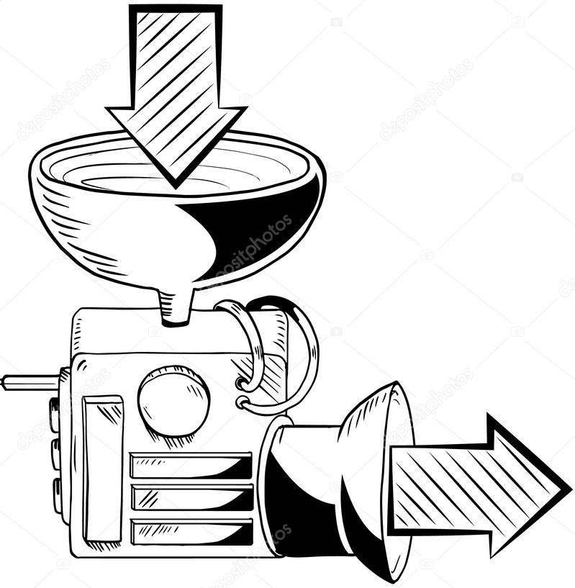

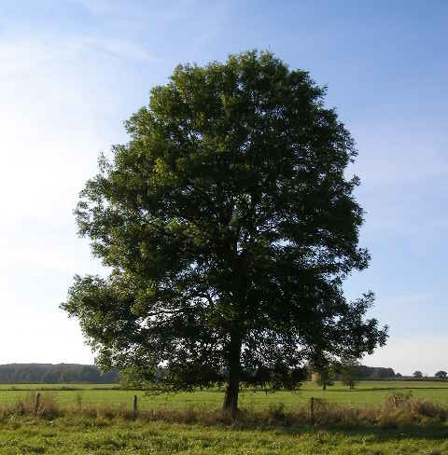
Models Utilised
Random Forest
SVM
(Support Vector Machine)
BERT
(Bidirectional Encoder Representations from Transformers)
Naive Bayes Classifier
VADER
(Valence Aware Dictionary for Sentiment Reasoning)
Decision Tree
Traditional Machine Learning Models
Non- Traditional Machine Learning Models
Notes:
For our project, we utilised 6 models as shown here. We have 4 traditional machine learning models,namely: Random Forest, Decision Tree Support Vector Machine (or SVM) and Naive Bayes.
And we have 2 non-traditional machine learning models, namely: Bidirectional Encoder Representations from Transformers (or BERT) and Valance Aware Dictionary for Sentiment Reasoning (or VADER).
For the three traditional models, our data would require some preprocessing like feature vectorising and lemmatisation. We will talk more about this later on.
Now onto the three traditional machine learning models.
A random forest is a type of machine learning algorithms that is used for both classification and regression tasks. It is an ensemble learning method that combines multiple decision trees to make predictions.
The Random Forest works by constructing a large number of decision trees on randomly selected subsets of the training data. Each decision tree in the random forest is built independently using a different subset of the training data and a random subset of the features. The final prediction is then made by aggregating the predictions of all the decision trees in the forest.
Next, the Support Vector Machine (SVM) is a supervised machine learning algorithm that is also used for classification and regression tasks. It works by constructing a hyperplane or a set of hyperplanes that can be used to separate data into different classes. SVM finds the optimal hyperplane by maximizing the margin between the hyperplane and the nearest data points of each class.
Lastly, Naive Bayes. This is a probabilistic machine learning algorithm that is widely used for classification tasks, such as spam filtering, sentiment analysis, and document classification. It is based on Bayes' theorem and assumes that the features are independent of each other, hence the term "naive".
Naive Bayes works by calculating the probability of a given data point belonging to each class, based on the probabilities of the features. It uses Bayes' theorem to calculate the posterior probability of a class given the data point and the prior probability of the class. The class with the highest posterior probability is then selected as the predicted class for the data point.

Slide 32
Traditional Machine Learning Models
Decision Tree &
Random Forest
Support Vector Machine (SVM)
Naive Bayes Classifier
Data requires preprocessing (feature vectorising)
Lemmatization (run, ran, running -> all becomes run)
Notes:
For the three traditional models, our data would require some preprocessing like feature vectorising and lemmatization. We will talk more about this later on.
Now onto the three models.
A random forest is a type of machine learning algorithms that is used for both classification and regression tasks. It is an ensemble learning method that combines multiple decision trees to make predictions.
The Random Forest works by constructing a large number of decision trees on randomly selected subsets of the training data. Each decision tree in the random forest is built independently using a different subset of the training data and a random subset of the features. The final prediction is then made by aggregating the predictions of all the decision trees in the forest.
Next, the Support Vector Machine (SVM) is a supervised machine learning algorithm that is also used for classification and regression tasks. It works by constructing a hyperplane or a set of hyperplanes that can be used to separate data into different classes. SVM finds the optimal hyperplane by maximizing the margin between the hyperplane and the nearest data points of each class.
Lastly, Naive Bayes. This is a probabilistic machine learning algorithm that is widely used for classification tasks, such as spam filtering, sentiment analysis, and document classification. It is based on Bayes' theorem and assumes that the features are independent of each other, hence the term "naive".
Naive Bayes works by calculating the probability of a given data point belonging to each class, based on the probabilities of the features. It uses Bayes' theorem to calculate the posterior probability of a class given the data point and the prior probability of the class. The class with the highest posterior probability is then selected as the predicted class for the data point.

Slide 33
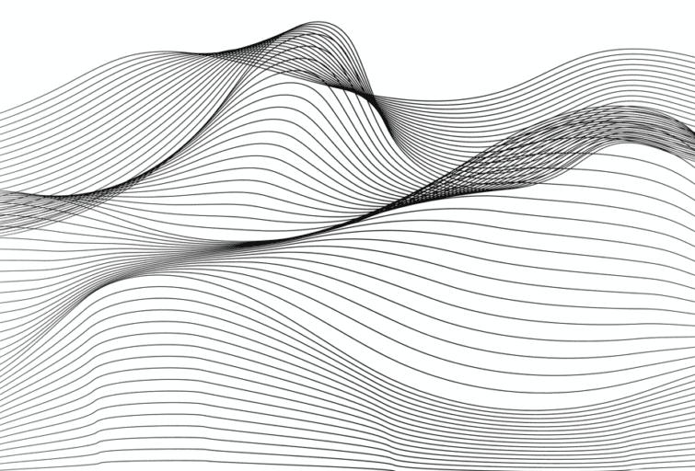


Neural Network Based (BERT)
Bidirectional Encoder Representations from Transformers
Neural Network Based
(Transformer Architecture)
Able to perform wide tasks in NLP
Pre-trained on Large Corpus
Notes:
Now we move on to the Bidirectional Encoder Representations from Transformers (or BERT). This model is a pre-trained language model developed by Google's AI research team.
It is a deep neural network that is trained on a large amount of textual data to understand the natural language of the text and is based on the Transformer architecture, which is a type of neural network that is designed to process sequential data, such as natural language.
BERT is pre-trained on a large corpus of text data using a technique called unsupervised learning. During the pre-training process, BERT learns to understand the relationships between words and the context in which they are used.
This enables BERT to perform a wide range of natural language processing tasks, such as sentiment analysis, text classification, and question answering.
BERT also does not require any data preprocessing and feature selection.

Slide 34
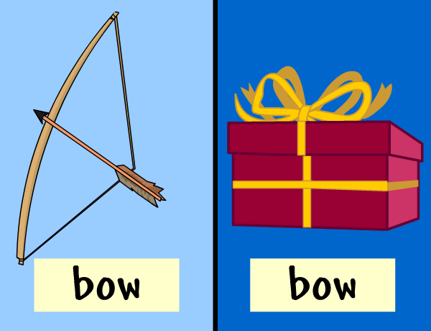


Lexicon Based Model (VADER)
Valence Aware Dictionary for sEntiment Reasoning
Sentiment analysis model
(Especially social media content)
Handle the slang, sarcasm, negation, etc.
Pre-defined dictionary score words
(Syntactical rules will also be concerned)
Notes:
Lastly, we have the Valence Aware Dictionary and sEntiment Reasoner (or VADER). It is a rule-based sentiment analysis tool developed by researchers at the Georgia Institute of Technology. It is designed to analyze the sentiment of text, especially social media content, by taking into account the context and intensity of the language used.
VADER uses a lexicon of words and phrases with predetermined sentiment scores, such as positive, negative, or neutral. The tool also takes into account grammatical and syntactical rules, such as punctuation and capitalization, to improve its accuracy. VADER assigns sentiment scores to each sentence in a given text, indicating the overall positive or negative sentiment of the text.

Slide 35

Methodology
Specific Data
Model Trained on
Test on
General Data
Model Trained on
Test on

Slide 36
RQ2. Which model would perform better across different domains? (TripAdvisor vs Other Datasets)
Other Datasets (Sentiment) : Support Vector Machine (SVM)
Models | Average Accuracy (Sentiment)
Naive Bayes | 67.3%
Decision Tree | 58.0%
Random Forest | 68.3%
SVM | 69.8%
BERT | 52.7%
VADER

Slide 37
RQ2. Which model would perform better across different domains? (TripAdvisor vs Other Datasets)
Other Datasets (Rating) : Random Forest
Models | Average Accuracy (Rating)
Naive Bayes | 49.0%
Decision Tree | 46.8%
Random Forest | 50.0%
SVM | 46.3%
BERT
VADER
Notes:
However, it is worth noting that for Naive Bayes, the results omitted the rating of 2 and 3.

Slide 38
Image References
What is Sentiment Analysis?
TripAdvisor Review: https://www.tripadvisor.com/Hotels-g664891-Macau-Hotels.html
Emotion Image: https://toppandigital.com/us/blog-usa/machine-translation-multilingual-sentiment-analysis-projects/
Types of Sentiment Analysis
Dictionary Image: https://www.britannica.com/summary/dictionary
Machine Learning Image: https://www.atriainnovation.com/en/machine-learning-in-industry/
Traditional Machine Learning & Deep Learning Image: https://www.guru99.com/machine-learning-vs-deep-learning.html
Models Utilised
Bert Image: https://open.spotify.com/artist/1T8DNeUI0R8aw3GNwvqeax
Darth Vader Image: https://www.starwars.com/databank/darth-vader
Forest Image: https://www.treehugger.com/woods-vs-forest-5182505
Machine Image: https://depositphotos.com/60499021/stock-illustration-crazy-machine-showing-input-and.html
Naive Bayes Image: https://hackr.io/blog/top-steps-to-learn-naive-bayes-algorithm
Traditional Machine Learning Models
Random Forest Image: https://www.tibco.com/reference-center/what-is-a-random-forest
SVM Image: https://towardsdatascience.com/svm-feature-selection-and-kernels-840781cc1a6c
Naive Bayes Image: https://www.analyticsvidhya.com/blog/2022/03/building-naive-bayes-classifier-from-scratch-to-perform-sentiment-analysis/
Neural Network Based (BERT)
Transformer Architecture Image: https://www.datameer.com/blog/what-is-a-semantic-layer/
Pre-Trained Image: https://www.reddit.com/r/datasets/
Perform Wide Tasks Image: https://www.efilecabinet.com/efficiency-vs-productivity/

